Slide 1
E-Commerce
Olist Store Analysis Project
Venkat Sai Kishan Parida
Vemuru Vinay Kumar Reddy
Shiva Vikrant Shrivastava
Rishvith Ld
Navjot singh
G.Divya
Sakshi Bapu Gangurde

Slide 2
Agenda
01
Project Overview
05
SQL Dashboard
02
Excel Dashboard
06
KPI and it’s overview
03
PowerBi Dashboard
07
Business Improvement Recommendations
04
Tableau Dashboard
08
Challenges Faced
09
Conclusion

Slide 3
Project Overview
This project is based on the Olist E-commerce dataset, which contains information about orders, customers, products, payments, reviews, and sellers.
The main goal of the project is to analyze sales performance, customer behavior, delivery efficiency, and payment trends.
Different tools such as Excel, Power BI, Tableau, and SQL were used to perform data cleaning, analysis, visualization, and KPI tracking.
The dashboard helps identify important business insights like customer satisfaction, regional purchasing patterns, delivery performance, and preferred payment methods.
Based on the analysis, the project also provides recommendations for improving logistics, sales strategy, and overall customer experience.

Slide 4
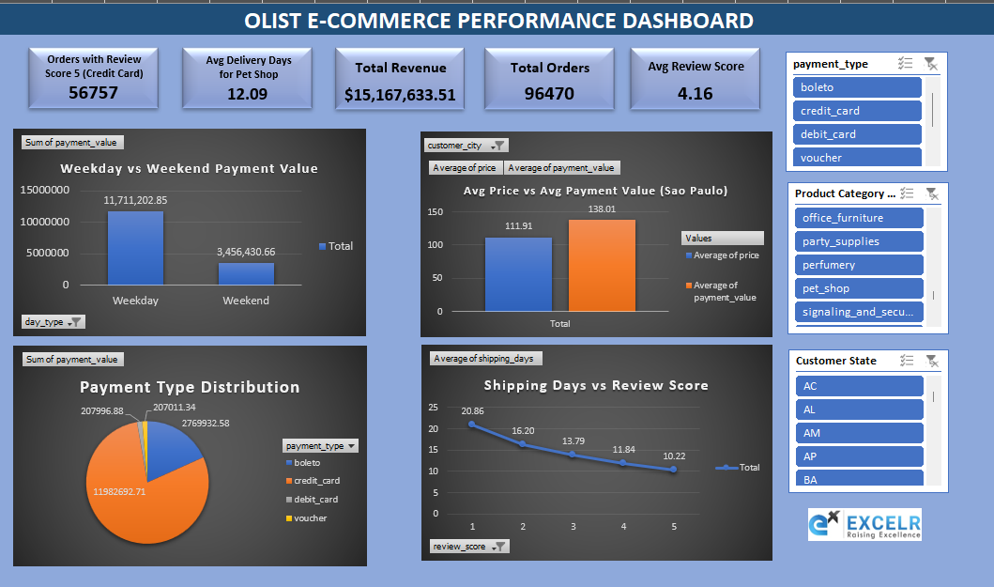
Excel Dashboard

Slide 5
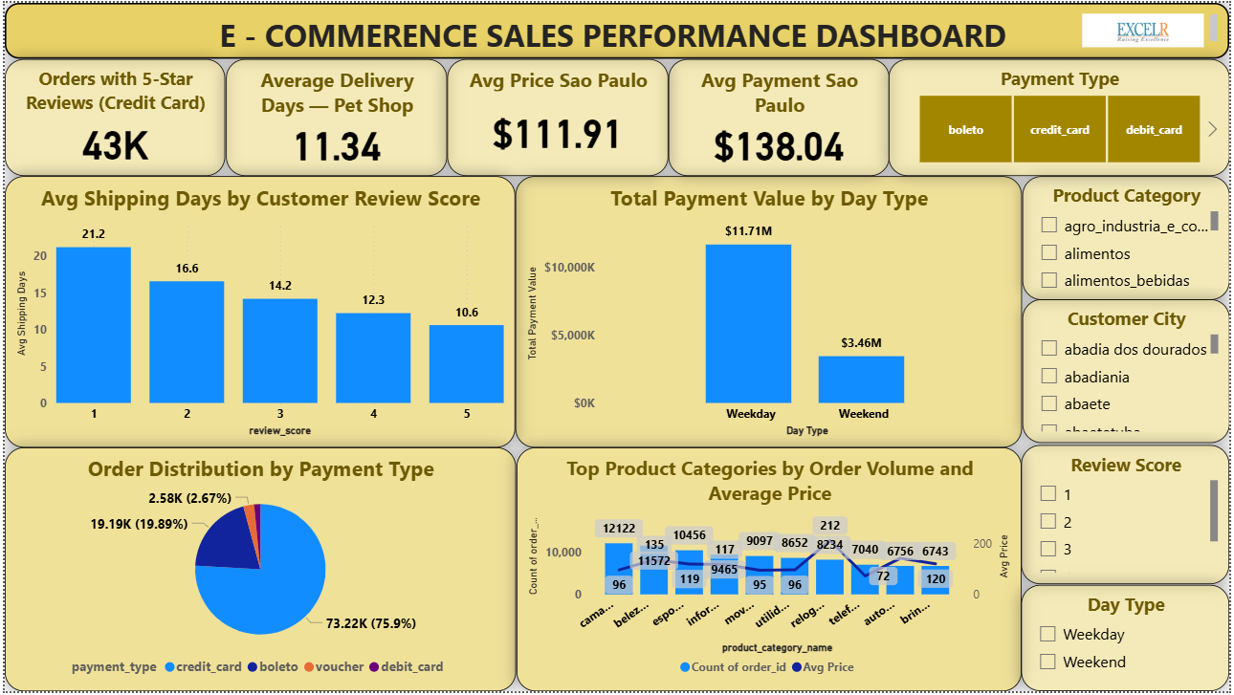
PowerBi Dashboard

Slide 6
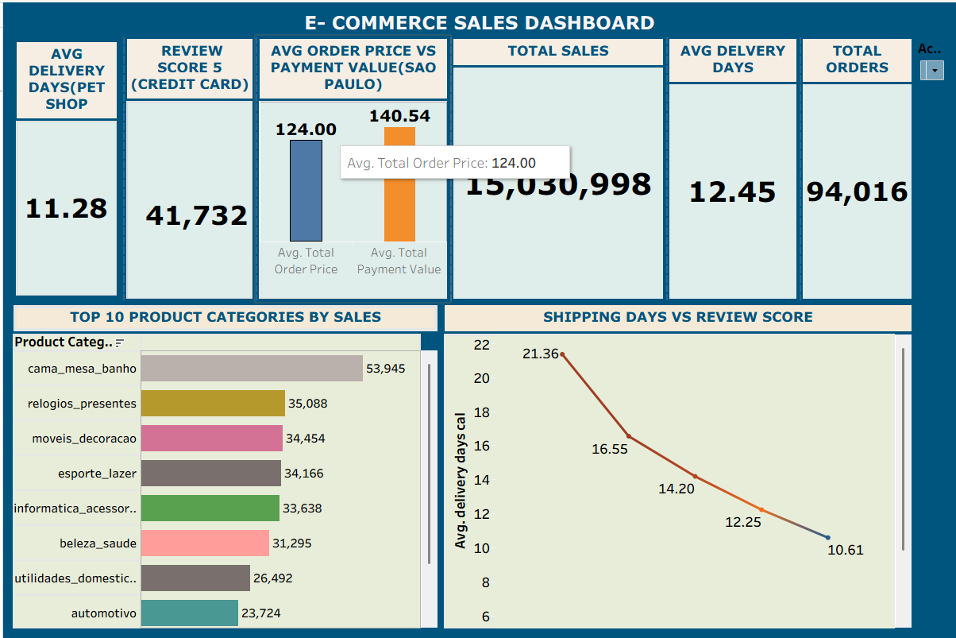
Tableau Dashboard

Slide 7
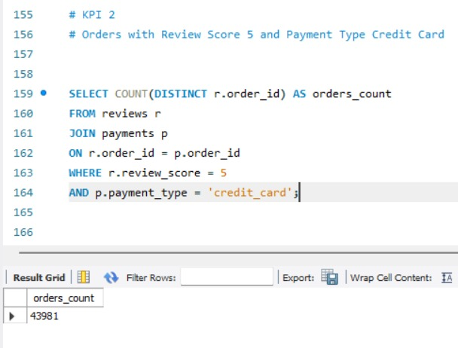
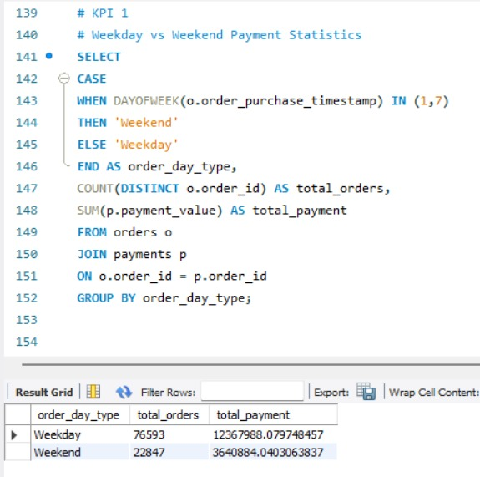
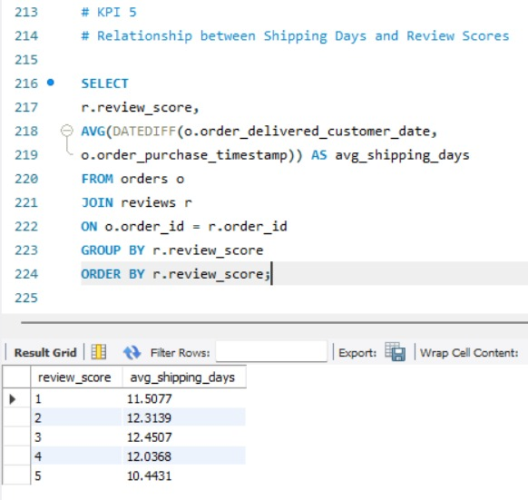
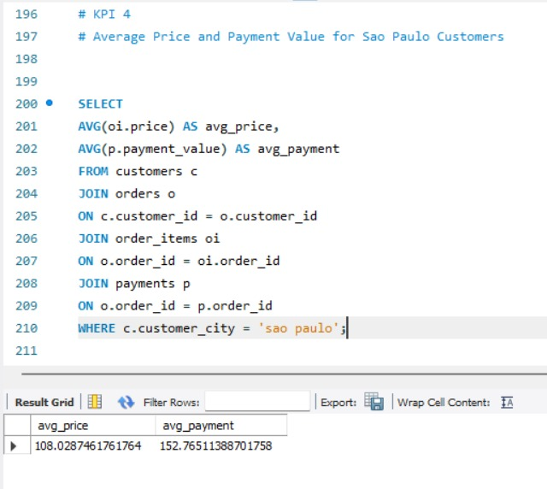
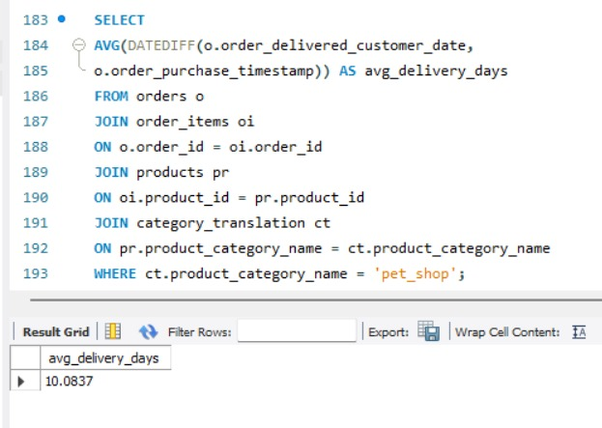
SQL Dashboard

Slide 8
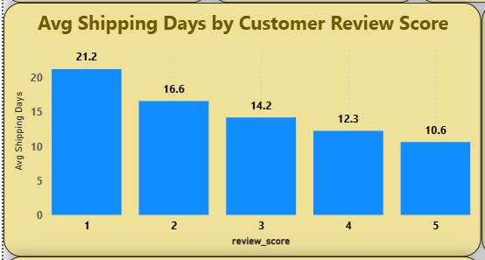

KPI and it’s overview
Delivery Time vs Customer Review Score
There is a clear negative relationship between delivery time and customer ratings.
Orders with faster delivery received better reviews, where as orders with longer delivery times received lower reviews.
Faster delivery is linked with higher customer ratings.
Delayed deliveries are strongly associated with poor reviews.
Logistics performance directly impacts customer experience.

Slide 9

Business Improvement Recommendations
Main area where the company is lacking
Delivery efficiency :
Weekend Sales Performance :
Because low-rated orders are taking much longer to reach customers.
Weekday payment value is much higher than weekend payment value. This suggests the company is not generating enough weekend purchases.
What company should do:
Optimize shipping and Delivery process.
Improve warehouse dispatch time.
Work with faster logistics partners.
Monitor delayed orders more strictly.
What company should do:
Introduce weekend offers and flash sales.
Provide limited-time discounts on weekends.
Run targeted campaigns on Friday evening and Saturday.
Strengthen category-wise logistics :
Some product categories may face slower delivery or different performance.
What company should do:
Monitor top-selling categories separately.
Improve stock availability for high-demand categories.
Prioritize fast-moving categories in fulfillment.

Slide 10
Challenges Faced
Managing multiple datasets and relationships was challenging.
Data cleaning and merging required careful checking.
Creating accurate KPI calculations in Power BI took time.
Ensuring slicers, filters, and visuals worked correctly was a key challenge.
Converting analysis into clear business insights was also an important part of the project.

Slide 11
Conclusion
This project helped us analyze the Olist E-commerce dataset using Excel, Power BI, Tableau, and SQL.
We identified key insights related to sales performance, customer satisfaction, delivery efficiency, and payment behavior.
The analysis showed that faster delivery leads to better customer reviews and that customer and sales trends can vary by city, category, and day type.
Based on the dashboard insights, we suggested improvements in logistics, weekend sales strategy, and fulfillment planning.
Overall, this project demonstrates how data analytics can support better business decisions and performance improvement.

Slide 12
Thank You

